Slide 1
Data Structures and Algorithms(CSE2001)
MODULE 2
Linear Data Structure- Linked List
(Stack & Queue using Linked List and Recursion)

Slide 2
Stack using Linked List
As we already know, stacks are linear data structures. This means that their contexts are stored in what looks like a line. An array, too, is a sort of linear data structure in which you can access any element directly. However, in a stack, you can only access the element at its top.

Slide 3
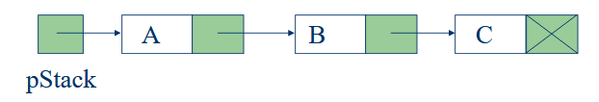
Stack using Linked List (contd...)
One disadvantage of using an array to implement a stack is the wasted space – most of the time, most of the array is unused. A more elegant and economical implementation of a stack uses a linked list, which is a data structure that links together individual data objects as if they were ‘links’ in a “chain” of data.

Slide 4
Stack using Linked List (contd...)
The question here is, where should we consider the top of the stack to be, the beginning or end of the list, and why?

Slide 5
Where should be the top of the stack?
Since the stack ADT uses a LIFO manner to retrieve data, the top of the stack is where all objects are added, and also retrieved from. Therefore, it is necessary that the programmer evaluates the pros and cons on figuring out if the top of the stack should be at the head of the linked list or at the tail.

Slide 6
Top of the stack at the tail
Imagine the scenario where the top of the stack is at the end of the linked list. Since the stack ADT uses a LIFO manner to retrieve data, in this case, new objects would have to be added to the end of the linked list, and retrieved from the end of the linked list too.

Slide 7
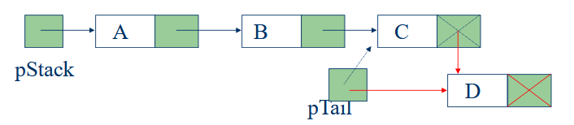
When the top is at the Tail – push ( )
In order to add a new node, it would be necessary to traverse the linked list and find the end node. However, this could be taken care of with the help of tail node(pTail), along with the head pointer (pStack).

Slide 8
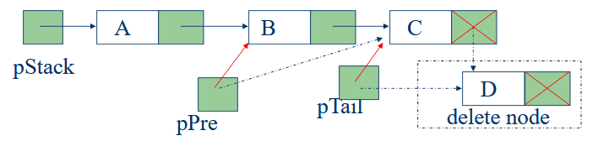
When the top is at the Tail – pop ( )
In order to delete a node, it would be necessary to traverse the linked list and find the end node. Can this be taken care of with the help of a pointer (pTail) and another pointer that always points to the previous pointer from the tail (pPre), along with the head pointer (pStack)?
Since there is no way to go backwards with this type of linked list, you will see that you would have to traverse the whole list to get to the previous pointer of pPre.

Slide 9
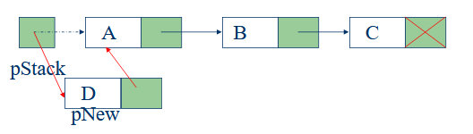
When the top is at the Head – push ( )
In this case, in order to add a new node, it would just add it to the head in this manner.

Slide 10
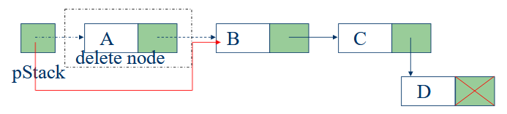
When the top is at the Head – pop ( )
In order to delete a node from the head, consider first node as a tempory node. Make head pointer to point to the next node and delete the temporary node from the linked list.

Slide 11
Queue using Linked List
Basic idea:
  Create a linked list to which items would be added to one end and deleted from the other end.
  Two pointers will be maintained:
    One pointing to the beginning of the list (point from where elements will be deleted).
    Another pointing to the end of the list (point where new elements will be inserted).
Rear
Front
DELETION
INSERTION

Slide 12
Queue using Linked List (contd...)
ENQUEUE
front
rear

Slide 13
Queue using Linked List (contd...)
DEQUEUE
front
rear

Slide 14
Recursion
In any programming language, it is possible for functions to call themselves.
A function is called recursive, if a statement within the body of the function calls the same function. This is also known as circular definition or self-reference.
There is a distinct difference between the normal and recursive functions.
  A normal function will be invoked by another function.
  A recursive function is invoked by itself directly or indirectly as long as the given condition is satisfied.

Slide 15
Recursion (contd...)
Every recursive function must satisfy the following two criteria or properties.
  Base criteria: There must be at least one base criteria or condition in the recursion process, such that, when this condition is met the function stops calling itself recursively.
  Recursive step: The recursive calls should progress in such a way that each time a recursive call is made it comes closer to the base criteria.
A recursive function that satisfies the above two properties is said to be a well-defined recursive function.

Slide 16
Recursion Process / Understanding Base Condition
In a recursive program, the solution can have one or more base cases (base criteria) . A base case is a terminating scenario that does not use recursion to produce the result/solution to the problem.
int Fact (int n){
if (n==0 || n==1) //Base Cases
return 1;
else
return n * fact(n-1);
In the above example, a base case n==1 or n==1 is defined and for all other values of n that are greater than one (1), the programming logic tends to reach closer to the base case, by subtracting one from n in each iteration.
For example, while computing factorial(n) we also calculate factorial(n - 1).
The base case for the factorial would be n = 0. And the code would return 1 when n = 0.

Slide 17
Recursion Process / Understanding Base Condition (contd...)
If base case is not reached or not defined, then the stack overflow problem may arise. Let us consider the below example:
int fact(int n) {
// wrong base case (it may cause stack overflow)
if (n == 100)
return 1;
else
return n * fact(n - 1);
}
If fact(10) is called, it will call fact(9), fact(8), fact(7) and so on but the value represented by n will never reach 100. So, the base case will never be reached (satisfied).
In such scenarios, the memory on the stack will get filled by the recursive function calls, resulting in an error called stack overflow error.

Slide 18
Recursion Process
While using recursion, programmers need to be careful to define an exit condition from the function, otherwise, the calls might result in an infinite loop.
Recursive functions are very useful to solve many mathematical problems like calculating factorial, generating Fibonacci series, solving Tower of Hanoi puzzle, etc.
When a recursive function is executed, all the recursive calls are pushed onto the stack until the terminating condition is not detected.
When the terminating condition is detected, the recursive calls stored in the stack are popped and executed. The last call is executed first then second, then third and so on.

Slide 19
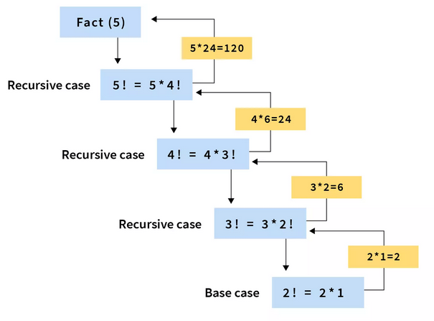
Recursion – To find the factorial of a given number

Slide 20
Recursion – To find the factorial of a given number (contd...)
import java.util.Scanner;
public class Factorial {
int fact(int n) {
if (n==0 || n==1)
return 1;
else
return n*fact(n-1);
}
public static void main(String[] args) {
int n;
Factorial t = new Factorial();
System.out.print("Enter the number to compute factorial: ");
Scanner sc = new Scanner(System.in);
n = sc.nextInt();
System.out.print("Factorial of " + n + " is: " + t.fact(n));
}
}

Slide 21
Recursion – Towers of Hanoi Puzzle
The Towers of Hanoi is a classic mathematical puzzle (inspired from the puzzle Tower of Brahma) used in computer programming.
In this there are three rods, one of the rods (called source) contains a stack of disks of different sizes.
The objective of the puzzle is to move the entire stack present in the source rod to another rod which is called the destination rod.
While moving the disks, one has to follow the following rules:
Only one disk can be moved at a time.
While moving a disk, only the topmost disk can be moved at a time.
Larger disks can't be placed on top of the smaller disks.

Slide 22
Recursion – Towers of Hanoi Puzzle (contd...)
The solution of moving n disks from source to destination can be divided into the three following steps.
Step-1:
Moving top n - 1 disks from source rod to temporary rod using destination rod as temporary.
After Step-1, we have only 1 disk i.e the largest disk in the source node and the destination node will be empty.
Step-2:
Move the n^{th} disk from source to destination.
After Step-2 , the source rod is empty and the biggest disk is moved to destination.
Step-3:
Move the n - 1 disks from the temporary rod to the destination rod using source rod (which is empty After Step-2) as the intermediate node.
The base condition here is if the number of disks is 1 then we need to just move that disk from sourse to destination.

Slide 23
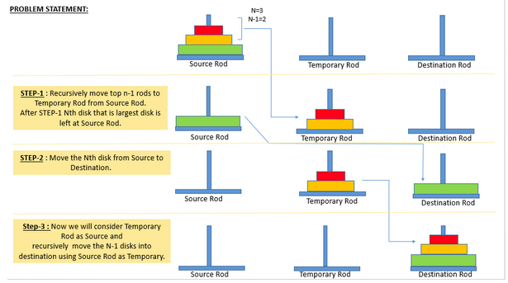
Recursion – Towers of Hanoi Puzzle (contd...)
The three steps can be easily understood using the following diagram:

Slide 24
Recursion – Towers of Hanoi Puzzle (contd...)
import java.util.Scanner;
public class TowerOfHanoi {
public void towerOfHanoiMethod(int n, char a, char b, char c){
if (n==1){
System.out.println("Move disk - 1 from pole " + a + " to " + c);
return;
}
towerOfHanoiMethod(n-1, a, c, b);
System.out.println("Move disk - "+n+ " from pole " + a + " to " + c);
towerOfHanoiMethod(n-1, b, a, c);
}
public static void main(String[] args) {
int n;
TowerOfHanoi t = new TowerOfHanoi();
System.out.print("Enter number of disks : ");
Scanner sc = new Scanner(System.in);
n = sc.nextInt();
t.towerOfHanoiMethod(n, 'A', 'B', 'C');
}
}

